Slide 1

Security and Fire Detection System using Deep Learning Techniques
Scientific computing Department
Faculty of Computer and information science
Ain shams university

Slide 2
Team Members
Ahmed Said Nouh Ibrahim
Ahmed Tarek Fathy Mohamed
Nada Magdy Abdelkarim Baba
Khaled Ahmed Abdelzaher Mohamed
Ahmed Khaled Ahmed Abdella
Supervised By
Prof Dr. Hala Mosheir
TA. Radwa Reda Hossieny

Slide 3
Agenda
01
02
03
04
Introduction
Problem Definition
Motivation
Objective
05
Experimental Results
Literature Review
06
Demo
System Architecture
07
Conclusion
Implementation Techniques
08
Future Work

Slide 4
01
Problem Definition

Slide 5
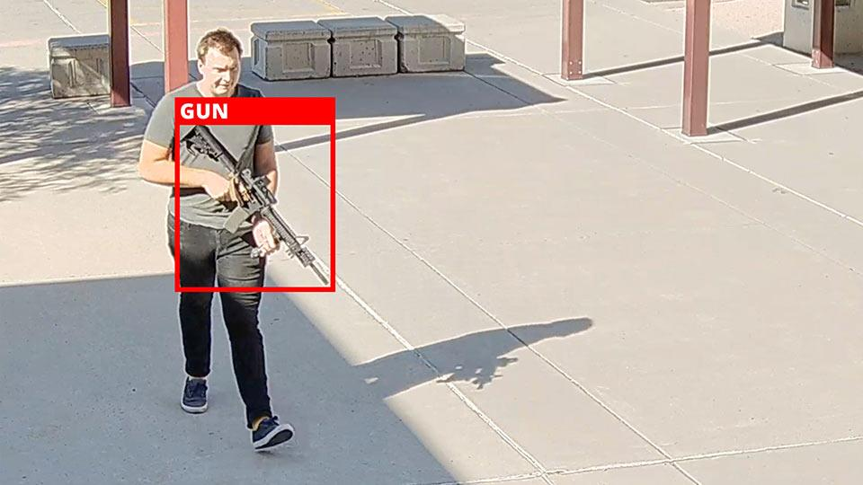
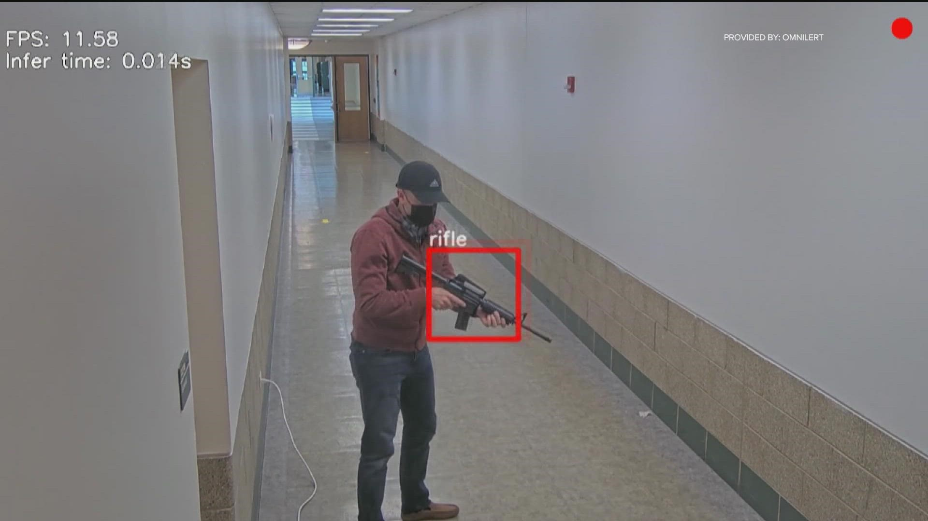
Problem Definition
Recently, the challenges of security systems in protecting citizens from crime and disasters have become very difficult. While some organizations have developed security systems to detect crimes, the number of incidents of theft and hostage-taking indicates the inadequacy of existing security systems. In addition, analyzing video frames can be difficult and expensive.

Slide 6
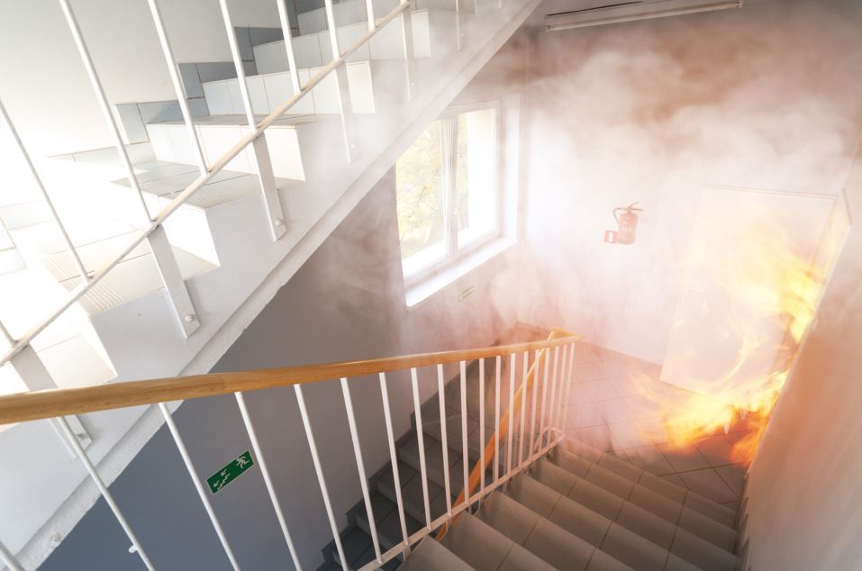
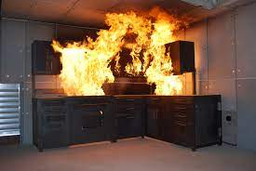
Problem Definition
Fire disasters happen in our lives, and we cannot avoid them, they also cause the loss of precious live, they bring great harm to human beings, nurture, public safety and cost the countries. so, technology have made it possible to detect them early so we prepare ourselves when the disasters occur.

Slide 7
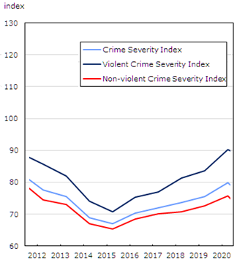
Motivation
Government and private institutions are exposed to severe attacks and armed robbery at the present time, especially if within these organizations a special organization for financing, such as banks.
According to the World Health Organization. Every year, more than 15,000 people die in violent crimes. About 40% of these murders are committed with sharp cold steel weapons.

Slide 8
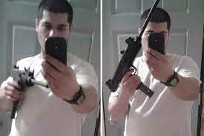
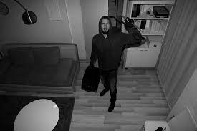
Objective
The objective of this project is to Development Real-time security and fire detection systems using Deep Learning Models

Slide 9
Benefits
Real-time Fire Detection
Face Recognition
01
02
To catch fires from destroying facilities
To prevent the spread of outlaws
Guns Detection
03
Quickly detect crimes before they happen by detecting weapons with visiting people

Slide 10
Literature Review

Slide 11
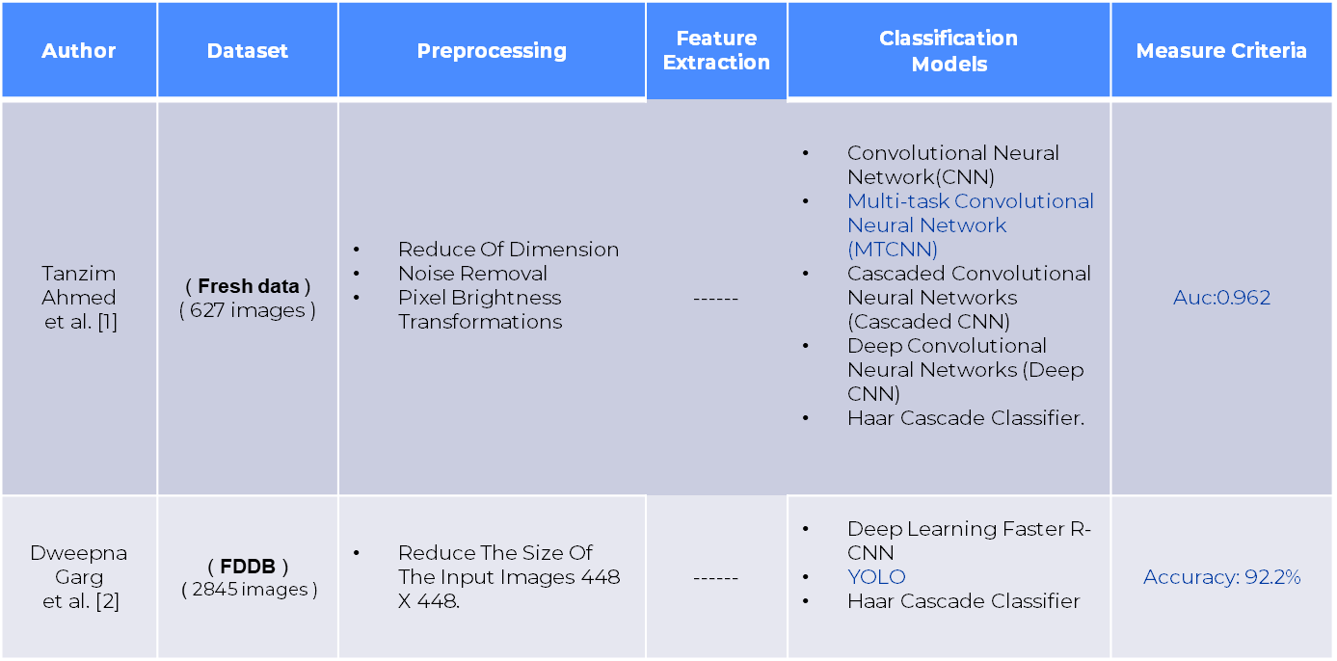
Face Recognition

Slide 12
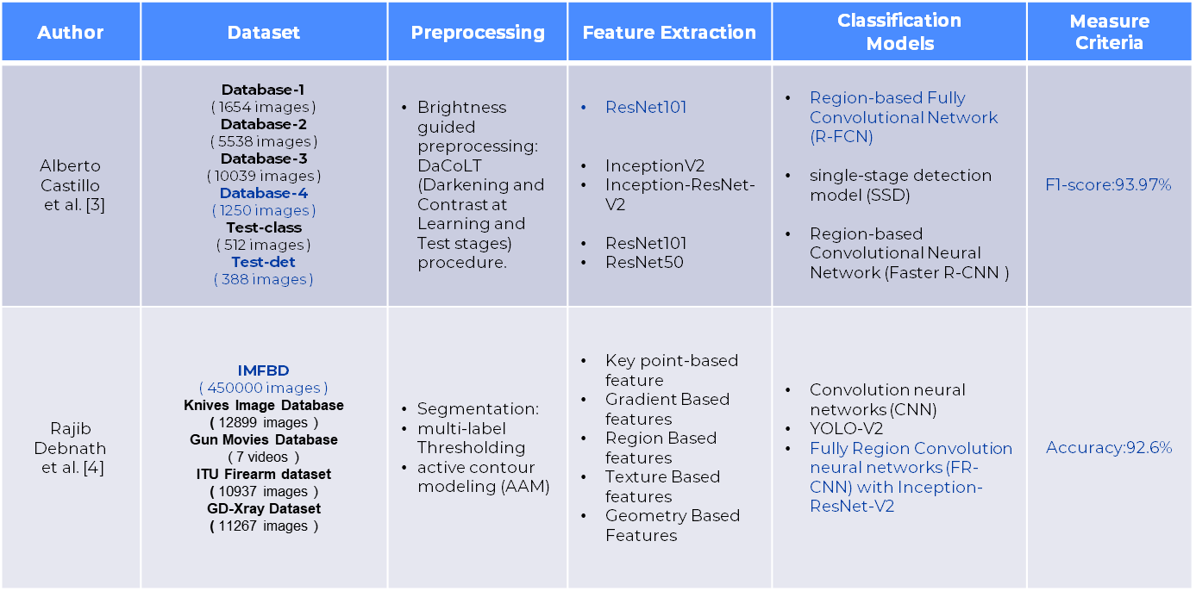
Weapons Detection

Slide 13
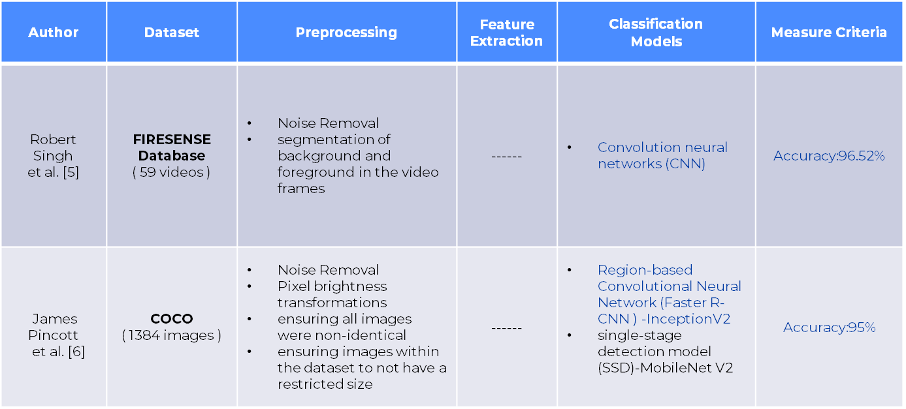
Fire Detection

Slide 14
System Architecture

Slide 15
System Architecture
Pre- Processing
Pre- Processing
Feature Extraction
Deep Learning Models
Datasets
Datasets
Classification
Wanted
Have gun
Fire
unwanted
Not Have gun
Non- fire

Slide 16
Implementation Techniques

Slide 17
Implementation Techniques Datasets
Face Recognition
Weapons Detection
Dataset size: 6000 image
20 classes
Train: 4200 images (70%)
Test: 1800 images (30%)
Dataset size: 720 image
4 classes
Train: 504 images (70%)
Test: 216 images (30%)
Fire Detection
Dataset size: 1800 image
2 classes
Train: 1260 images (70%)
Test: 540 images (30%)

Slide 18
Implementation Techniques Preprocessing
Noise Removal
Control Brightness
01
02
using
Gaussian filter with size filter 3
- Median filter with size filter 5
using sigmma correction 0.7
Resize images
03
resize all images to average size of image
equal (422,322)

Slide 19

Implementation Techniques CNN
No human supervision , High accuracy at image recognition , weight sharing , minimize computation and same knowledge across all image location

Slide 20
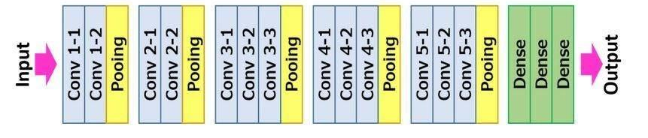
Implementation Techniques VGG16
achieved excellent results on the ILSVRC-2014 (ImageNet competition) , very effective at extracting features from images and easy to implement .

Slide 21
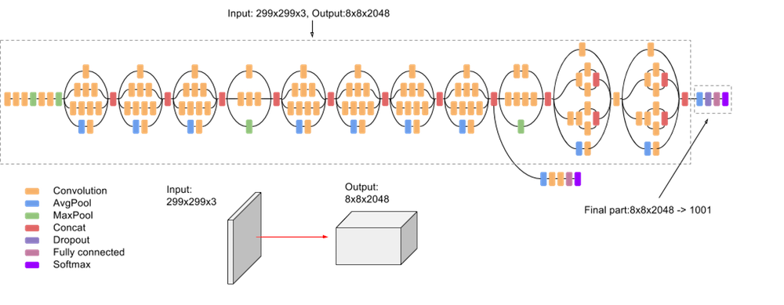
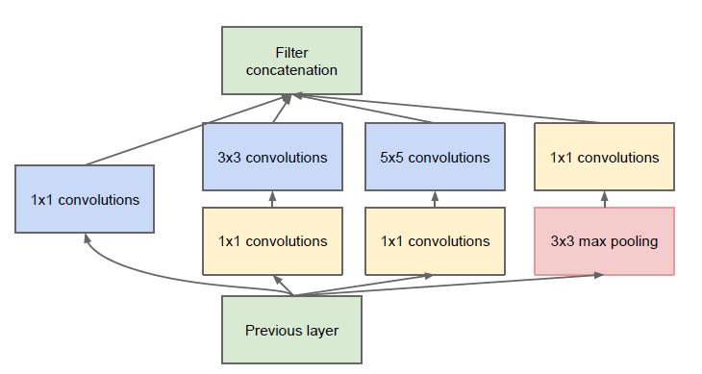
Implementation Techniques Inception V3
higher efficiency , has a deeper network compared to the Inception V1 and V2 models, but its speed isn't compromised , computationally less expensive, uses auxiliary Classifiers as regularizes.

Slide 22
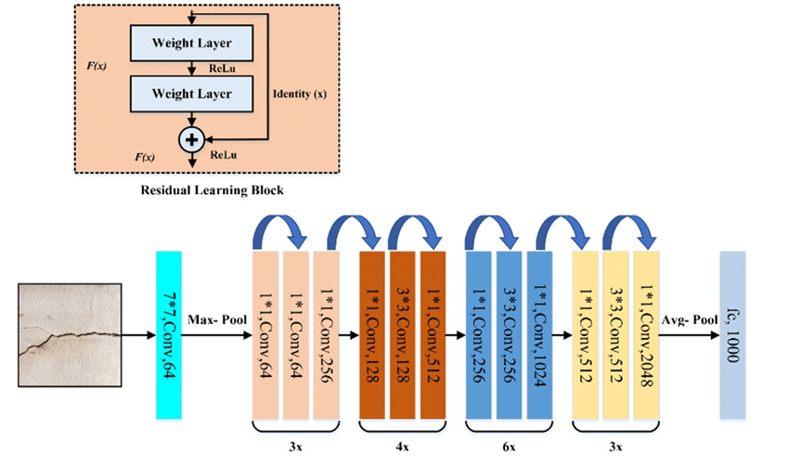
Implementation Techniques ResNet50
Networks with large number (even thousands) of layers can be trained easily without increasing the training error percentage , tackling the vanishing gradient problem using identity mapping

Slide 23
Implementation Results

Slide 24
Results Of Face Recognition: CNN
EXPERIMENTS | Average Accuracy
Experiment 1 ( without Preprocessing ) With Epochs 70 | 83.00%
Experiment 2 ( without Preprocessing ) With Epochs 80 | 82.33%
Experiment 3 ( Preprocessing ) With Epochs 90 | 84.33%

Slide 25
Results Of Face Recognition: InceptionV3
EXPERIMENTS | Average Accuracy
Experiment 1 ( Without Preprocessing ) With Epochs 300 | 71.67%
Experiment 2 ( Preprocessing ) With Epochs 300 | 74.33%
Experiment 3 ( Preprocessing ) With Epochs 600 | 93.39%

Slide 26
Results Of Face Recognition: VGG-16
EXPERIMENTS | Average Accuracy
Experiment 1 ( Without Preprocessing ) With Epochs 50 | 70%
Experiment 2 ( Without Preprocessing ) With Epochs 70 | 81%
Experiment 3 ( Preprocessing ) With Epochs 70 | 91.52%

Slide 27
Results Of Face Recognition: summary
93.3%
91.52%
83%
82.3%
81%
71.6%
74.3%
70%

Slide 28
Results Of Weapons Detection: VGG16
EXPERIMENTS | Average Accuracy
Experiment 1 ( without Preprocessing ) With Epochs 250 | 91.67 %
Experiment 2 ( Preprocessing ) With Epochs 140 | 92.13%
Experiment 3 ( Preprocessing ) With Epochs 115 | 95.5%

Slide 29
Results Of Fire Detection: VGG16
EXPERIMENTS | Average Accuracy
Experiment 1 Num. Epochs= 1 | 99.7%
Experiment 2 Num. Epochs= 2 | 93.3%
Experiment 3 Num. Epochs= 3 | 98.44%

Slide 30
SYSTEM DEMO

Slide 31


Slide 32
Conclusion

Slide 33
The proposed system is an integrated and advanced security system Real Time that combines the detection of people, weapons, and fires Using Deep Learning Techniques.
For face recognition, The experimental results proved the superiority of Inception V3 model ,it achieved an average accuracy of 93%, with average processing time of 3 seconds/ action
For weapon recognition, The experimental results proved the superiority VGG16 model, it achieved an average accuracy of 95.5 %, with average processing time of 4 seconds/ action
For fire recognition, The experimental results proved the superiority of VGG16 , it achieved an average accuracy of 99.7 %, with average processing time of 0.2 seconds/ action

Slide 34
Future Work

Slide 35
More attempts might be done to enhance the performance of the proposed system without increasing the processing time.
Increasing the number of videos and classes in the used datasets.
Applying different pre-processing techniques.
Applying different Deep Learning models in classification.
The application can be launched after all the improvements are made to help governmental and special institutes.

Slide 36
References

Slide 37
References
Islam, Towfiqul & Ahmed, Tanzim & Rashid, A & Islam, Taminul & Rahman, Md & Habib, Md. (2022). Convolutional Neural Network Based Partial Face Detection. 10.48550/arXiv.2206.14350.
Garg, Dweepna & Goel, Parth & Pandya, Sharnil & Ganatra, Amit & Kotecha, Ketan. (2018). A Deep Learning Approach for Face Detection using YOLO. 1-4. 10.1109/PUNECON.2018.8745376.
Castillo Lamas, Alberto & Tabik, Siham & Pérez, Francisco & Olmos, Roberto & Herrera, Francisco. (2018). Brightness guided preprocessing for automatic cold steel weapon detection in surveillance videos with deep learning. Neurocomputing. 330. 10.1016/j.neucom.2018.10.076.
Debnath, Rajib & BHOWMIK, MRINAL. (2021). A comprehensive survey on computer vision-based concepts, methodologies, analysis and applications for automatic gun/knife detection. Journal of Visual Communication and Image Representation. 78. 103165. 10.1016/j.jvcir.2021.103165.
Robert Singh, A. & Suganya, A. & Narayanan S, Sankara & Subbiah, Dhanasekaran. (2021). Fire Detection by Parallel Classification of Fire and Smoke Using Convolutional Neural Network. 10.1007/978-981-33-6862-0_8.
Pincott, James & Tien, Paige & Wei, Shuangyu & Calautit, John Kaiser. (2022). Indoor fire detection utilizing computer vision-based strategies. Journal of Building Engineering. 61. 105154. 10.1016/j.jobe.2022.105154.

Slide 38
THANK YOU
Do you have any questions?
Security and Fire Detection System using Deep Learning Techniques

